Slide 1

Unit-5
Graphs

Slide 2
Contents
Introduction to Graphs, Memory representation of graphs, Warshalls’ algorithm, operations on Graphs, Breadth First Search, Depth First Search
Sorting : Insertion Sort, Selection Sort, Radix sort, Merge Sort.

Slide 3
Graph vs Tree
NO. | GRAPH | TREE
1 | Graph is a non-linear data structure. | Tree is a non-linear data structure.
2 | It is a collection of vertices/nodes and edges. | It is a collection of nodes and edges.
3 | Each node can have any number of edges. | General trees consist of the nodes having any number of child nodes. But in case of binary trees every node can have at the most two child nodes.
4 | There is no unique node called root in graph. | There is a unique node called root in trees.
5 | A cycle can be formed. | There will not be any cycle.
6 | Applications: For finding shortest path in networking graph is used. | Applications: For game trees, decision trees, the tree is used.

Slide 4

Graphs & Sorting Algorithms
A Graph is a non-linear data structure consisting of nodes and edges. The nodes are sometimes also referred to as vertices and the edges are lines or arcs that connect any two nodes in the graph.

Slide 5
This graph G can be defined as G = ( V , E ) Where V = {A,B,C,D,E} and
E={(A,B),(A,C)(A,D),(B,D),(C,D),(B,E),(E,D)}.
Edge- Undirected Edge, Directed Edge, Weighted Edge.
Undirected Graph- A graph with only undirected edges is said to be undirected graph.
Directed Graph - A graph with only directed edges is said to be directed graph.

Slide 6
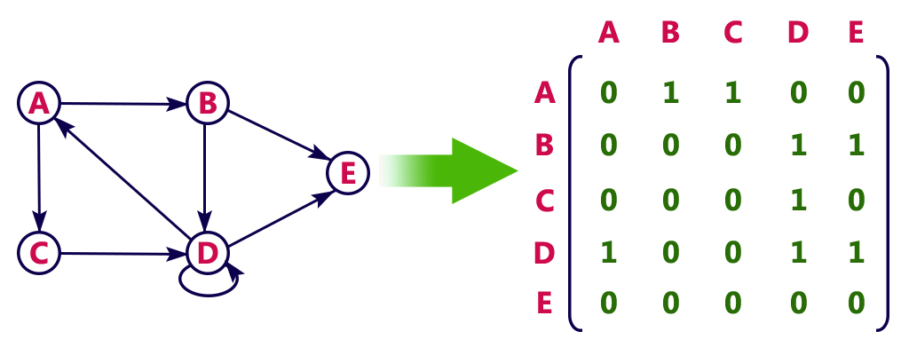
Memory representation of graphs
Adjacency Matrix
Suppose G is the simple directed graph with m nodes, and suppose the node of G have been ordered and are called v1,v2,v,3..Vm.Adjacencymatrix A = (aij) of the graph G is the m*m matrix defined as follows
aij= 1 if vi is adjacent to vj, if there is an edge (vi, vj)
= 0 othewise

Slide 7
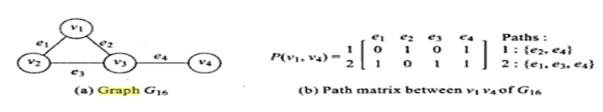
Path Matrix Representation
A path matrix is generally defined for a specific pair of vertices then the path matrix denoted as P(u,v) = Pij .
Pij = 1 if the jth edge lies in the ith path
= 0 otherwise

Slide 8
Breadth-First Search
Breadth first search is a graph traversal algorithm that starts traversing the graph from root node and explores all the neighbouring nodes. Then, it selects the nearest node and explore all the unexplored nodes. The algorithm follows the same process for each of the nearest node until it finds the goal.

Slide 9
BFS Algorithm
Step 1: SET STATUS = 1 (ready state) for each node in G
Step 2: Enqueue the starting node A and set its STATUS = 2 (waiting state)
Step 3: Repeat Steps 4 and 5 until QUEUE is empty
Step 4: Dequeue a node N. Process it and set its STATUS = 3 (processed state).
Step 5: Enqueue all the neighbours of N that are in the ready state (whose STATUS = 1) and set their STATUS = 2 (waiting state) [END OF LOOP]
Step 6: EXIT

Slide 10
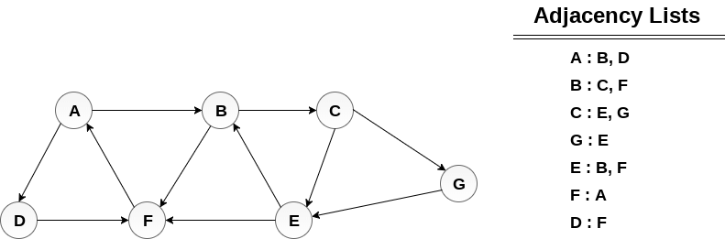
Minimum Path P can be found by applying breadth first search algorithm that will begin at node A and will end at E. the algorithm uses two queues, namely QUEUE1 and QUEUE2. QUEUE1 holds all the nodes that are to be processed while QUEUE2 holds all the nodes that are processed and deleted from QUEUE1.
Lets start examining the graph from Node A.
1. Add A to QUEUE1 and NULL to QUEUE2.
QUEUE1 = {A}
QUEUE2 = {NULL}
2. Delete the Node A from QUEUE1 and insert all its neighbours. Insert Node A into QUEUE2
QUEUE1 = {B, D}
QUEUE2 = {A}
3. Delete the node B from QUEUE1 and insert all its neighbours. Insert node B into QUEUE2.
QUEUE1 = {D, C, F}
QUEUE2 = {A, B}
4. Delete the node D from QUEUE1 and insert all its neighbours. Since F is the only neighbour of it which has been inserted, we will not insert it again. Insert node D into QUEUE2.
QUEUE1 = {C, F}
QUEUE2 = { A, B, D}
5. Delete the node C from QUEUE1 and insert all its neighbours. Add node C to QUEUE2.
QUEUE1 = {F, E, G}
QUEUE2 = {A, B, D, C}
6. Remove F from QUEUE1 and add all its neighbours. Since all of its neighbours has already been added, we will not add them again. Add node F to QUEUE2.
QUEUE1 = {E, G}
QUEUE2 = {A, B, D, C, F}
7. Remove E from QUEUE1, all of E's neighbours has already been added to QUEUE1 therefore we will not add them again. All the nodes are visited and the target node i.e. E is encountered into QUEUE2.
QUEUE1 = {G}
QUEUE2 = {A, B, D, C, F, E}
Now, backtrack from E to A, using the nodes available in QUEUE2.
The minimum path will be A → B → C → E.

Slide 11
Depth-First Search
Depth first search (DFS) algorithm starts with the initial node of the graph G, and then goes to deeper and deeper until we find the goal node or the node which has no children. The algorithm, then backtracks from the dead end towards the most recent node that is yet to be completely unexplored.

Slide 12
DFS Algorithm
Step 1: SET STATUS = 1 (ready state) for each node in G
Step 2: Push the starting node A on the stack and set its STATUS = 2 (waiting state)
Step 3: Repeat Steps 4 and 5 until STACK is empty
Step 4: Pop the top node N. Process it and set its STATUS = 3 (processed state)
Step 5: Push on the stack all the neighbours of N that are in the ready state (whose STATUS = 1) and set their STATUS = 2 (waiting state) [END OF LOOP]
Step 6: EXIT

Slide 13
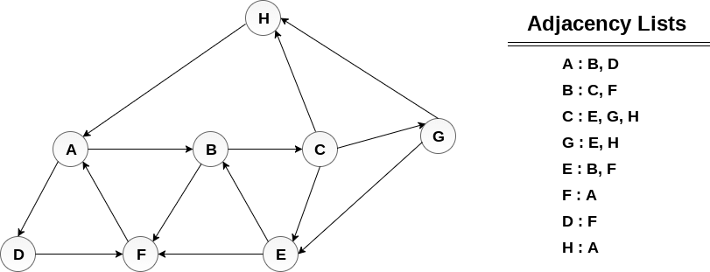
Push H onto the stack
STACK : H
POP the top element of the stack i.e. H, print it and push all the neighbours of H onto the stack that are is ready state.
Print H
STACK : A
Pop the top element of the stack i.e. A, print it and push all the neighbours of A onto the stack that are in ready state.
Print A
Stack : B, D
Pop the top element of the stack i.e. D, print it and push all the neighbours of D onto the stack that are in ready state.
Print D
Stack : B, F
Pop the top element of the stack i.e. F, print it and push all the neighbours of F onto the stack that are in ready state.
Print F
Stack : B
Pop the top of the stack i.e. B and push all the neighbours
Print B
Stack : C
Pop the top of the stack i.e. C and push all the neighbours.
Print C
Stack : E, G
Pop the top of the stack i.e. G and push all its neighbours.
Print G
Stack : E
Pop the top of the stack i.e. E and push all its neighbours.
Print E
Stack :
Hence, the stack now becomes empty and all the nodes of the graph have been traversed.
The printing sequence of the graph will be :
H → A → D → F → B → C → G → E

Slide 14
Floyd Warshall’s Algorithm
An algorithm for finding shortest paths in a weighted graph with positive or negative edge weights
no negative cycles
find the lengths of the shortest paths between all pairs of vertices

Slide 15




Floyd Warshall’s Algorithm - what?
There are several paths between A and D:
5
2
3
4
Path 1: A -> B -> D
Path 2: A -> C -> D
= 7
= 7
Path 3: A -> B -> C -> D = 6

Slide 16
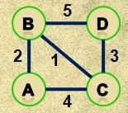
Shortest paths – mean?
There are several things to notice here:
There can be more then one route between two nodes.
The number of nodes in the route isn’t important (Path 3 has 4 nodes but is shorter than Path 1 or 2, which
has 3 nodes).
There can be more than one path of minimal length.

Slide 17
Example
1
2
3
1
0
4
5
1
W = D⁰ =
2
2
0
∞
5
3
∞
-3
0
4
2
3
1
2
3
2
-3
1
0
0
0
P =
2
0
0
0
3
0
0
0

Slide 18
k = 1 Vertex 1 can be intermediate node
1
1
2
3
5
D⁰ =
1
0
4
5
4
2
3
2
2
0
∞
2
-3
3
∞
-3
0
1
2
3
1
0
4
5
D¹ =
D¹[2,3] = min( D⁰[2,3], D⁰[2,1]+D⁰[1,3] )
= min (∝, 7)
= 7
D¹[3,2] = min( D⁰[3,2], D⁰[3,1]+D⁰[1,2] )
= min (-3,∝)
= -3
2
2
0
7
3
∞
-3
0

Slide 19
k = 2 Vertices 1, 2 can be intermediate
1
2
3
1
5
D¹ =
1
0
4
5
4
2
3
2
2
0
7
2
-3
3
∞
-3
0
1
2
3
1
0
4
5
D²[1,3] = min( D¹[1,3], D¹[1,2]+D¹[2,3] )
= min (5, 4+7)
= 5
D²[3,1] = min( D¹[3,1], D¹[3,2]+D¹[2,1] )
= min (∝, -3+2)
= -1
D² =
2
2
0
7
3
-1
-3
0

Slide 20
k = 3 Vertices 1, 2, 3 can be intermediate
1
1
2
3
5
D² =
1
0
4
5
3
4
2
2
2
0
7
2
-3
3
-1
-3
0
1
2
3
1
0
2
5
D³ =
D³[1,2] = min(D²[1,2], D²[1,3]+D²[3,2] )
= min (4, 5+(-3))
= 2
D³[2,1] = min(D²[2,1], D²[2,3]+D²[3,1] )
= min (2, 7+ (-1))
= 2
2
2
0
7
3
-1
-3
0

